Slide 1
TO PREDICT THE LOAN STATUS :Sammed Kesti

Slide 2
Business Objective: To predict the impact of the incident raised by the customer.

Slide 3
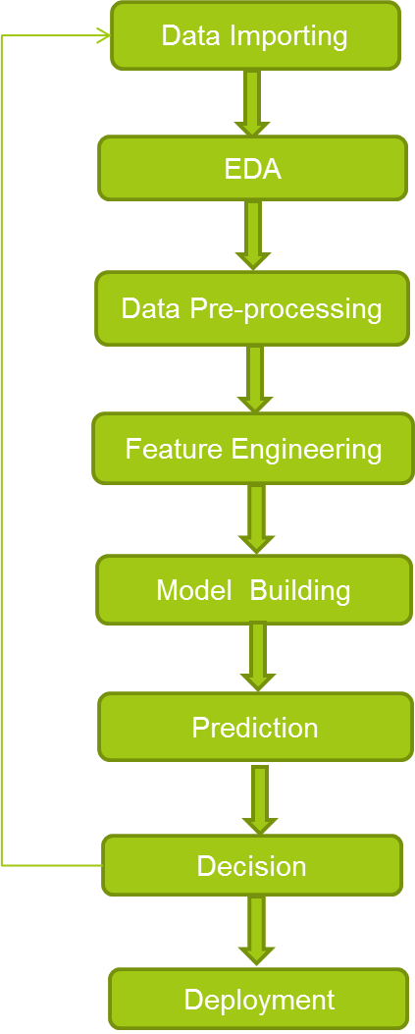
PROJECT FLOW

Slide 4
HYPOTHESIS GENERATION: Below are some of the factors which can be affect the Loan Approval prediction : 1.SALARY : Applicants with high salary/Income have higher chances of loan approval. 2.CREDIT HISTORY : Applicants who have good loan repayment history have high chances of loan approval. 3.LOAN AMOUNT : Lesser the loan amount ,higher is the approval rate. 4.LOAN TERM: lesser the loan term, higher the chances of approval.

Slide 5
DATA UNDERSTANDING

Slide 6


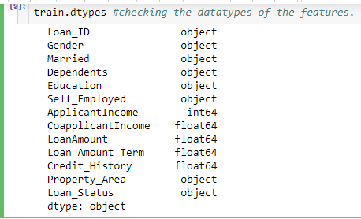
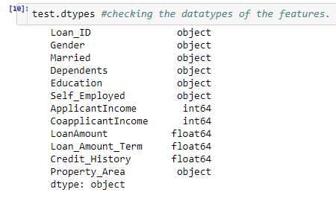
There are 614 data points in Train data set and 367 data points in Test data set.
There are 3 data types observed namely Object, Integer and Float. 1. Object data type : Loan_ID, Gender, Married, Dependents, Education, Self_Employed, Property_Area, Loan_Status in both Train and Test data set.
2. Integer data type : ApplicantIncome.
3. Float data type : CoapplicantIncome, LoanAmount, Loan_Amount_Term and Loan_Status.
Note: The data type of CoapplicantIncome in Test data set is Integer type
Train data: Test data:

Slide 7
EXPLORATORY DATA
ANALYSIS

Slide 8
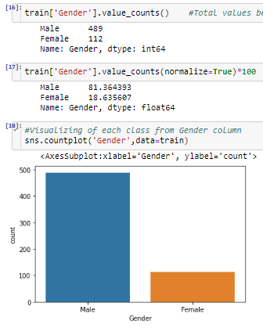
VISUALIZATION: The Visualization of the data is done with 2 analysis ways as following. 1. Univariate Analysis. 2. Bivariate Analysis.
EXPLORATORY DATA ANALYSIS:
Univariate Analysis : Independent Variables: Categorical Data Analysis
Analysis on variable ‘Gender’ :
Most of the applicants are male
81% of the applicants are male whereas 19% are female

Slide 9
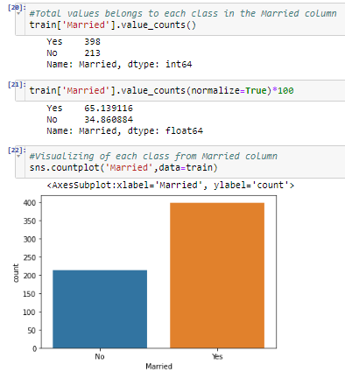
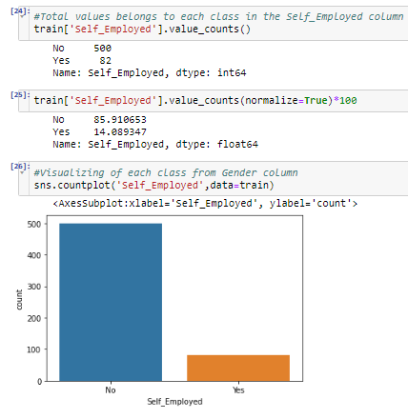
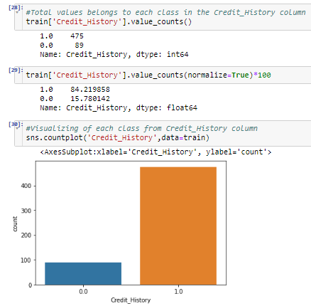
Analysis on variable ‘Married’, ‘Self_Employed’ and ‘Credit_History’ :
65% of the applicants are Married and remaining 35% are Female.
Most of the applicants are NOT Self_Employed i.e 86% of the applicants are not Self Employed.
Most of the applicants have cleared all the previous Debts. i.e 84% applicants have clear Credit History.

Slide 10
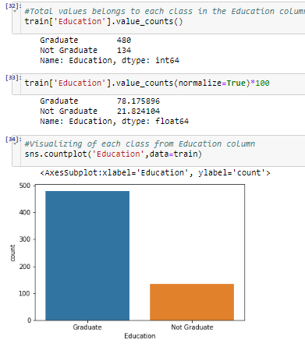
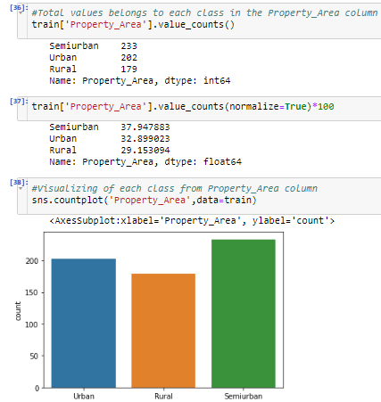
Ordinal Data Analysis
Analysis on variable ‘Education’ and ‘Property_Area’ :
Majority of applicants are Graduates i.e 78% of the applicants are Graduates remaining are not.
The applicants are distributed in all areas. But majority of applicants are with Semiurban area.
39% are from Semiurban, 33% are from Urban and 29% are from Rural respectively.

Slide 11
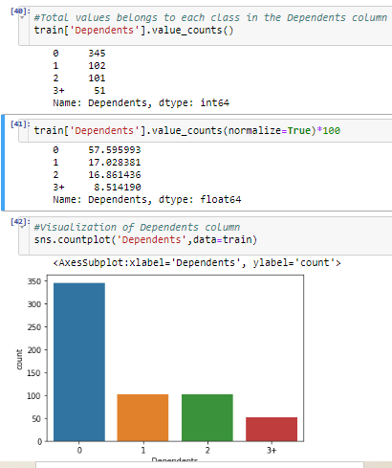
Analysis on variable ‘Dependents’ :
Majority of applicants have no dependents.
58% are with 0 dependents, 17% are with 1 dependents, 17% are with 2 dependents and 9% are with 3+ dependents.

Slide 12
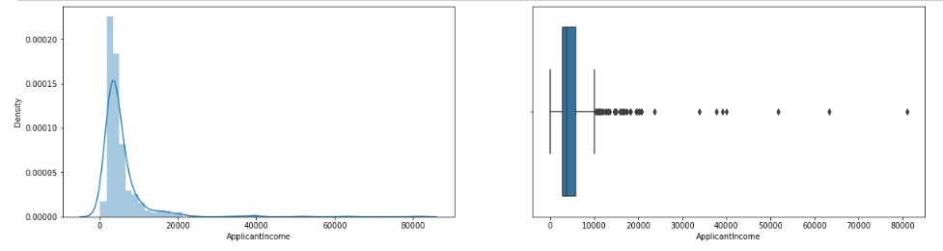
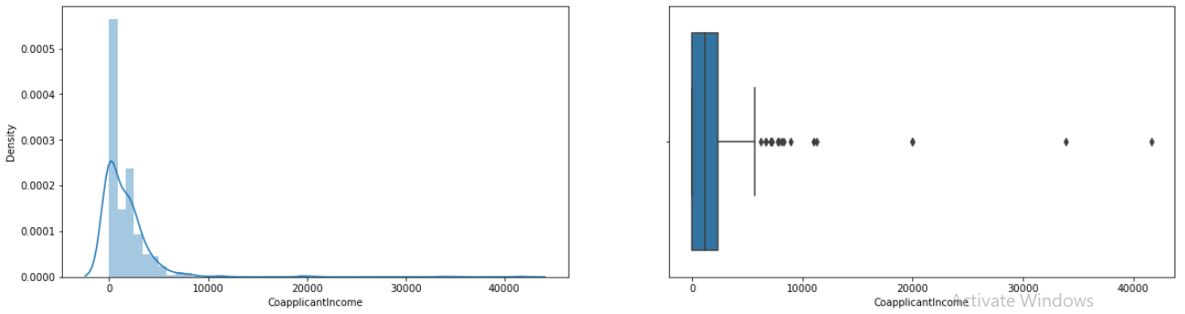
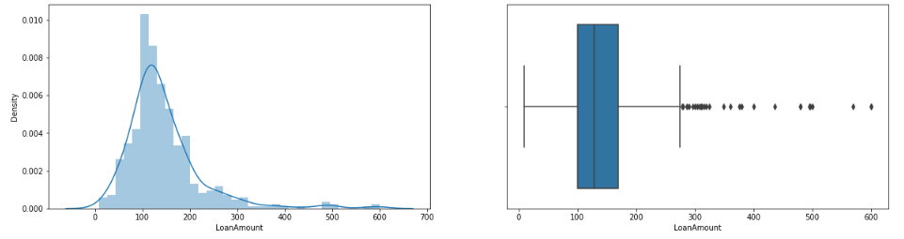
Numerical Data Analysis :
Analysis on variables
‘ApplicantIncome’, ‘CoapplicantIncome’ and ‘LoanAmount’ :
It is seen that all the numerical data of ApplicantIncome, CoapplicantIcome and LoanAmount are positively skewed as per the graph
All the numerical variables have Outliers.
The data normalization and outlier removal is done in the later section

Slide 13
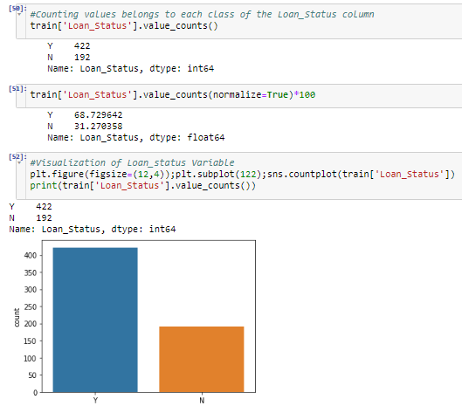
Analysis on Dependent Variable
Analysis on variable ‘Dependents’ :
It is observed that 69% of the applicants .
58% are with 0 dependents, 17% are with
1 dependents, 17% are with 2 dependents
and 9% are with 3+ dependents.

Slide 14
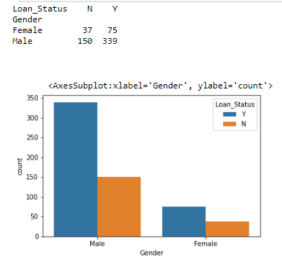
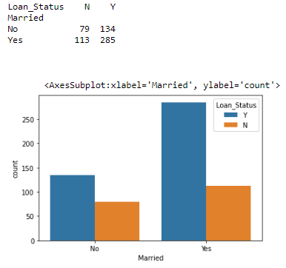
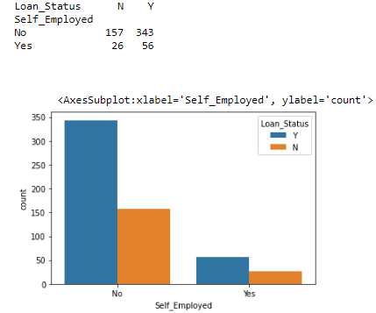
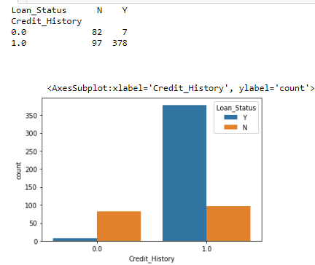
2) Bivariate Analysis: Categorical Independent variable vs Dependent variable We can conclude that the proportion of male and female applicants is more or less the same for both approved and unapproved loans. The proportion of married applicants is higher for approved loans. Distribution of applicants with 1 or 3+ dependents is similar across both the categories of Loan_Status. There is nothing significant we can infer from Self_Employed vs Loan_Status plot.

Slide 15
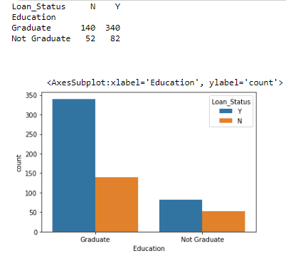
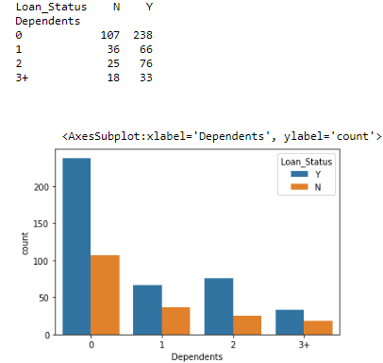
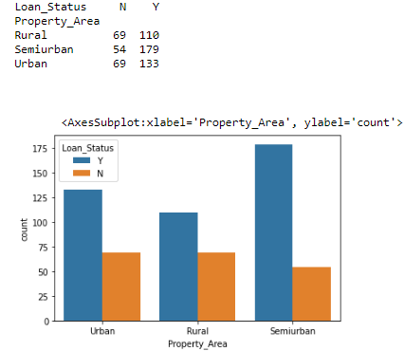
Ordinal Independent Variables Vs Dependent Variables:
Most of the people who are graduated got the loan and people who are not graduated also got the loan but with less proportion compared to graduated people.
The applicants with 0 dependents have more chances of approval.
The applicants who have property in semi-urban area have high chances to get loan.

Slide 16
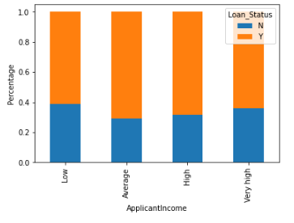
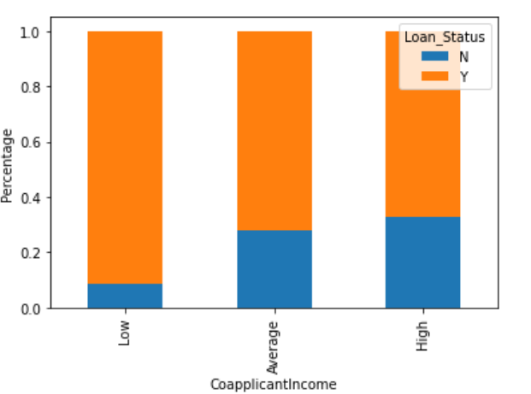
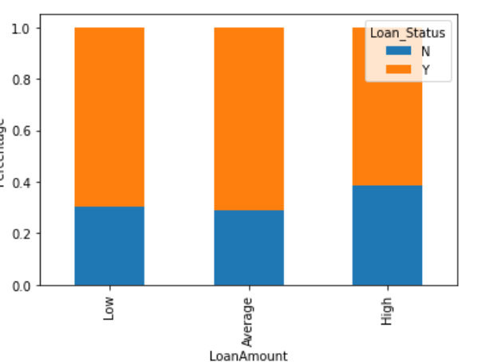
Numerical Independent Variables Vs Dependent Variables:
It can be inferred that Applicant's income does not affect the chances of loan approval.
May be that most of the applicants don’t have any co-applicant income that is co-applicant income for such applicants is 0 and hence the loan approval does not depend on it.
It can be seen that the proportion of approved loans is higher for Low and Average Loan Amount as compared to that of High Loan Amount which supports our hypothesis which we considered that the chances of loan approval will be high when the loan amount is less.

Slide 17
Data Processing

Slide 18
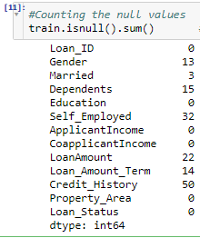
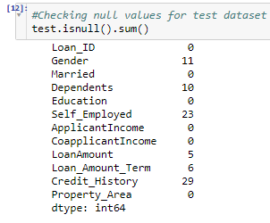
CHECKING THE MISSING/NULL VALUES:
It is found that both Train and Test data sets consists of null values, which will be treated further during the Preprocessing.
Train data: Test data:

Slide 19
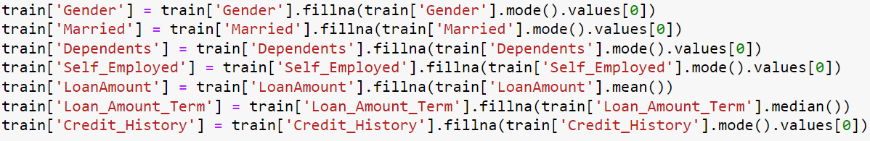
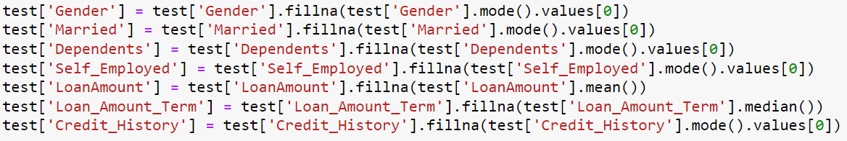
THERE ARE MISSING VALUES IN GENDER, MARRIED, DEPENDENTS, SELF_EMPLOYED, LOAN AMOUNT, LOAN_AMOUNT_TERM, AND CREDIT_HISTORY FEATURES. WE CAN TREAT THE MISSING VALUES IN ALL THE FEATURES TO BUILD A PERFECT MODEL WE CAN FILL THE MISSING VALUES USING THE BELOW OPTIONS: FOR NUMERICAL VARIABLES: IMPUTATION USING MEAN OR MEDIAN FOR CATEGORICAL VARIABLES: IMPUTATION USING MODE. WE HAVE PERFORMED THE SAME METHOD FOR BOTH TEST AND TRAIN DATA AND FILLED ALL THE MISSING VALUE
Missing/Null value Imputation

Slide 20

Dropping the Column
We can see that the column Loan-ID does not have any role in building the model, so we are going to drop it from both test and train datasets.

Slide 21
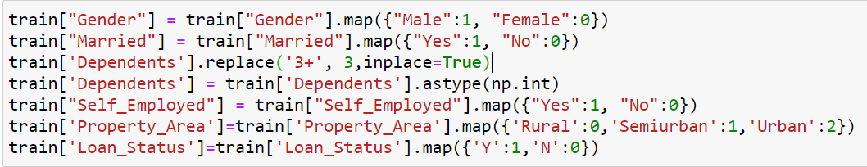
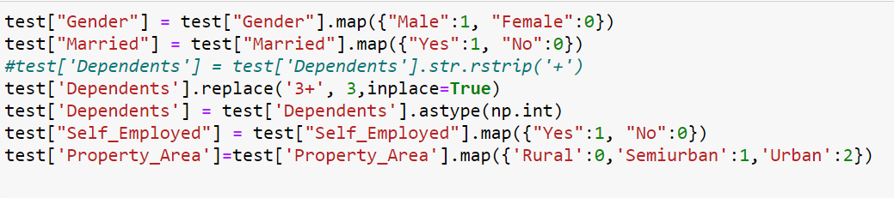
Conversion of categorical data into numerical data

Slide 22
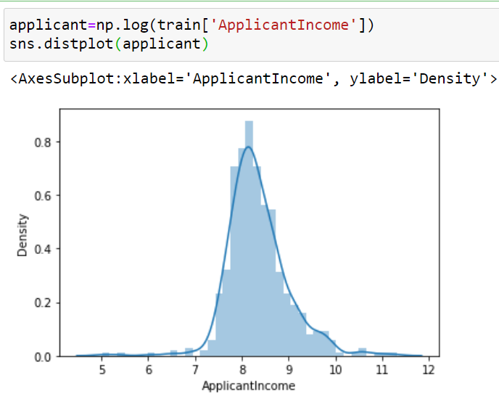
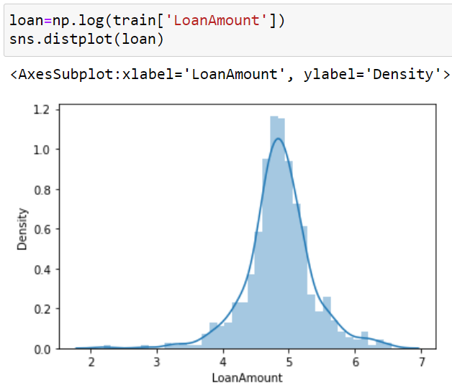
Outlier Treatment
As we saw earlier in univariate analysis, Loan Amount contains outliers so we have to treat them as the presence of outliers affects the distribution of the data.
Due to these outliers, a bulk of the data in the loan amount is placed more towards left and the right tail is longer leading to right skewness.
This can be removed by performing the log transformation. It does not affect the smaller values much but reduces the larger values. So, we get a distribution similar to normal distribution.
This is performed on both test as well as train data.

Slide 23
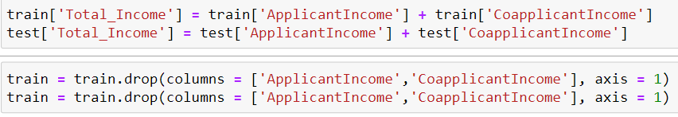
FEATURE ENGINEERING
Based on the basic understanding, we can come up with new features that might affect the target variable. We will create the following one new features:
Total Income : Applicant Income + Coapplicant Income.

Slide 24
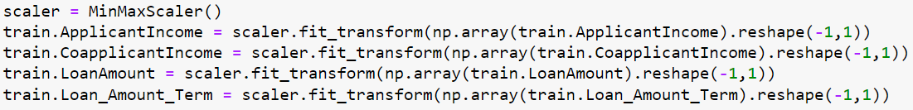
Normalizing the Data We have normalized the data using MinMaxScaler. We normalized only those columns which are numerical.

Slide 25
Model Summary

Slide 26
Model Summary
Model Name | Accuracy | Precision | ROC-AUC Score | F1-Score | Recall
Logistic Regression | 0.829268 | 0.817307 | 0.724616 | 0.890052 | 0.977011
Decision Tree | 0.772357 | 0.794123 | 0.684386 | 0.847826 | 0.896551
Random Forest | 0.822398 | 0.815242 | 0.738505 | 0.894736 | 0.977011
KNN | 0.772357 | 0.770642 | 0.635536 | 0.857142 | 0.965517
SVM | 0.817398 | 0.825242 | 0.738505 | 0.894736 | 0.977011
Naïve Bayes | 0.793658 | 0.811584 | 0.726283 | 0.904255 | 0.977011
XG-Boost | 0.756097 | 0.765294 | 0.713601 | 0.825581 | 0.816091
Neural Network | 0.793268 | 0.817307 | 0.724616 | 0.890052 | 0.977011

Slide 27
Model Summary
After building all the models we can conclude that the Logistic Regression model has upper hand as compared to other models.
So, we can conclude that Logistic Regression model is best fit model for given data set.

Slide 28
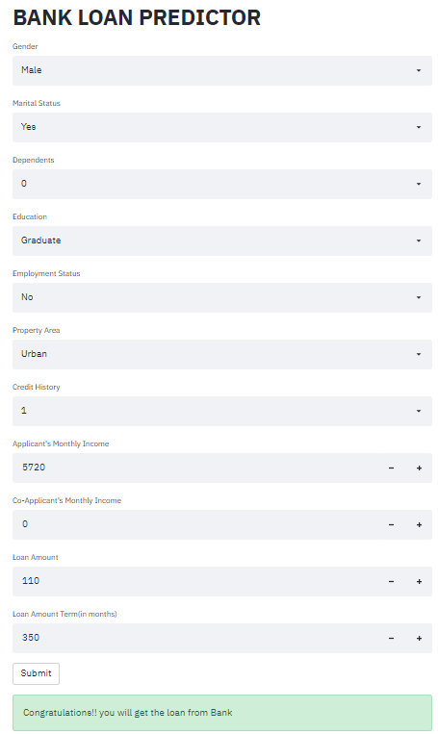
Model Deployment

Slide 29
Problems Faced
Data Processing
Feature Engineering
Model Building
Deployment

Slide 30
How we overcame
Case study from Analytics Vidya Portal
Research on Google
Read multiple articles on towardsdatascience.com

Slide 31
THANK YOU

